Slide 1
Ensemble Learning

Slide 2
Overview
Theory
Methods
Resampling Methods
Bagging
Randomization
Boosting
Hybrid Methods
Stacking
Implementations

Slide 3
Concepts
Occam’s Razor
“among the theories that are consistent with the data, select the simplest one”
Epicurus’ Principle
Principle of Multiple Explanations
“keep all theories that are consistent with the data”
The Condorcet Jury Theorem
“Aggregation of information from groups can results in improved decisions vs. an individual “expert” decision“
Notes:
By way of introducing ensemble learning I am going to discuss three concepts .
Occams Razor
Epicurus Principle
And The Condorcet Jury Theorem
The first we attribute to William of Ockham , Ockham did not invent the "razor"; but it has been attributed to him because of the frequency and effectiveness with which he used it (Ariew 1976). Ockham stated the principle in various ways, but the most popular version "entities must not be multiplied beyond necessity" was written by John Punch from Cork in 1639 (Meyer 1957).[13]
"We consider it a good principle to explain the phenomena by the simplest hypothesis possible."[
The anchient greek philospher Epicurus stated.
These two theorems may appear to be contradictory it is the goal in DM to learn to balance them to achieve best performance.
The Condorcet Jury Theorem stems from political science, the theorm on the relative probability of a given group of individual arriving at a correct decision.
Example
Francis Galton(1822- 1911): In the late 1860s, Galton conceived of a measure to quantify normal variation: the standard deviation. [25]In 1906, visiting a livestock fair, he stumbled upon an intriguing contest. An ox was on display, and the villagers were invited to guess the animal's weight after it was slaughtered and dressed. Nearly 800 participated, but not one person hit the exact mark: 1,198 pounds. Galton stated that "the middlemost estimate expresses the vox populi, every other estimate being condemned as too low or too high by a majority of the voters",[24] and calculated this value (in modern terminology, the median) as 1,207 pounds. To his surprise, this was within 0.8% of the weight measured by the judges. Soon afterwards, he acknowledged[25] that the mean of the guesses, at 1,197 pounds, was even more accurate.[26][27]

Slide 4
Ensemble-based Systems in Decision Making
For many tasks, we often seek second opinion before making a decision, sometimes many more
Consulting different doctors before a major surgery
Reading reviews before buying a product
Requesting references before hiring someone
We consider decisions of multiple experts in our daily lives
Why not follow the same strategy in automated decision making?
Multiple classifier systems, committee of classifiers, mixture of experts, ensemble based systems
Notes:
cPolikar R., “Ensemble Based Systems in Decision Making,” IEEE Circuits and Systems Magazine, vol.6, no. 3, pp. 21-45, 2006
Polikar R., “Bootstrap Inspired Techniques in Computational Intelligence,” IEEE Signal Processing Magazine, vol.24, no. 4, pp. 56-72, 2007
Polikar R., “Ensemble Learning,” Scholarpedia, 2008.

Slide 5
Ensemble-based Classifiers
Ensemble based systems provide favorable results compared to single-expert systems for a broad range of applications & under a variety of scenarios
How to
generate individual components of the ensemble systems (base classifiers), and
how to combine the outputs of individual classifiers?
Popular ensemble based algorithms
Bagging, boosting, AdaBoost, stacked generalization, and hierarchical mixture of experts
Commonly used combination rules
Algebraic combination of outputs, voting methods, behavior knowledge space & decision templates

Slide 6
Why Ensemble Based Systems?
Statistical reasons
A set of classifiers with similar training performances may have different generalization performances
Combining outputs of several classifiers reduces the risk of selecting a poorly performing classifier
Large volumes of data
If the amount of data to be analyzed is too large, a single classifier may not be able to handle it; train different classifiers on different partitions of data
Too little data
Ensemble systems can also be used when there is too little data; resampling techniques

Slide 7
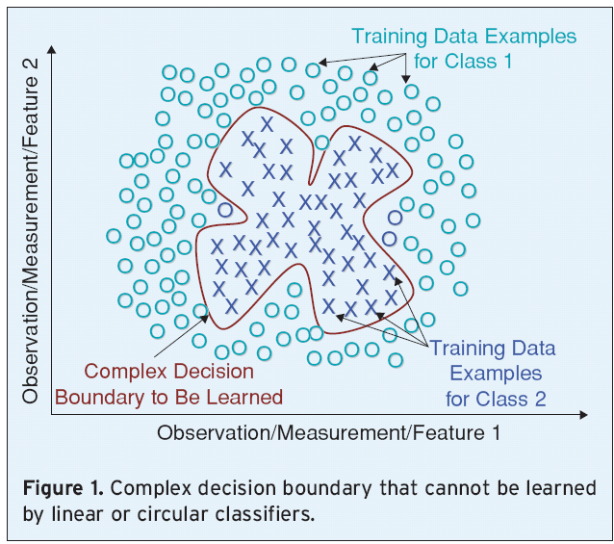
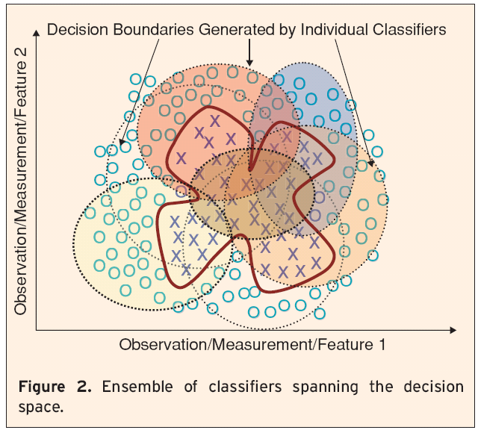
Why Ensemble Based Systems?
Divide and Conquer
Divide data space into smaller & easier-to-learn partitions; each classifier learns only one of the simpler partitions

Slide 8
Why Ensemble Based Systems?
Data Fusion
Given several sets of data from various sources, where the nature of features is different (heterogeneous features), training a single classifier may not be appropriate (e.g., MRI data, EEG recording, blood test,..)
Applications in which data from different sources are combined are called data fusion applications
Ensembles have successfully been used for fusion
All ensemble systems must have two key components:
Generate component classifiers of the ensemble
Method for combining the classifier outputs

Slide 9
Brief History of Ensemble Systems
Dasarathy and Sheela (1979) partitioned the feature space using two or more classifiers
Schapire (1990) proved that a strong classifier can be generated by combining weak classifiers through boosting; predecessor of AdaBoost algorithm
Two types of combination:
classifier selection
Each classifier is trained to become an expert in some local area of the feature space; one or more local experts can be nominated to make the decision
classifier fusion
All classifiers are trained over the entire feature space; fusion involves merging the individual (weaker) classifiers to obtain a single (stronger) expert of superior performance

Slide 10
Theory Ensemble Learning
Basic idea
Create multiple models
Build different “experts” by diversification
Select models that maximizes some performance criterion on a test set
Combine models into a single decision
Trained ensemble, represents a single hypothesis
Result
Improve reliability
Improve predictive performance
Notes:
Ensemble Definition
“A unit or group of complementary parts that contribute to a single effect”
Supervised learning algorithms
Can be applied to both classification and numeric prediction problems
Combine expert opinions.
Discuss diversification techniques as well as why it is important to diversiy the “experts/models/algrothms/learners”
Does everyone, or anyone understand what I mean by strong or weak classifier?
Weak Classifiers (weak learners)
Classifiers which perform slightly better than a random classifier. These are thus classifiers which have some predictive power.
Classifier which is only slightly correlated with the true classification (it can label examples better than random guessing)
Example: Decision Stump
Strong Classifier (strong learner)
classifier that is arbitrarily well-correlated with the true classification
Example: Naive Bayes, Neural Networks or SVM

Slide 11
Does it always work?
Models are only as good as their “experts”
Divergent ideas within a committee has the potential to strengthen an individual recommendation
ensembles tend to yield better results when there is a significant diversity among the models
Notes:
Not all crowds (groups) are “wise”. Example: crazed investors in a stock market bubble.
Not all crowds improve wisdom. If a commmittee were of all like minded people, the purpose behind the committee is lost.
there needs to be disagreement in a committee to have the potential to improve from individual
ensembles tend to yield better results when there is a significant diversity among the models
Pre-exisiting Bias

Slide 12
Weak vs. Strong Learners
Weak Classifiers (weak learners)
Classifiers which perform slightly better than a random classifier. These classifiers are considered have some predictive power.
Classifier which is only slightly correlated with the true classification (it can label examples better than random guessing)
Example: Decision Stump
Strong Classifier (strong learner)
classifier that is arbitrarily well-correlated with the true classification
Example: Naive Bayes, Neural Networks or SVM

Slide 13
Theory of Ensemble Learning
Supervised Learning Technique
Advantage
often improves predictive performance and reliability
Disadvantage
Produces output that is very hard to analyze
Loss of Interpretability: which factors contribute to the improved decision
Learning systems or performance system (vs. explanation system)
Requires additional compute cycles
Notes:
obtain better predictive performance than could be obtained from any of the models independently
Explanation systems build some human-readable intermediary, then use that intermediary to make predictions.
Performance systems don't bother with explaining themselves, they just make predictions.
In the above, decision trees are an explanation system and Naive Bayes was a performance system.

Slide 14
Key Criteria
Diversify
Decentralization
Specialized, local knowledge (colloquial wisdom)
Diversity of Opinion
private information, “even if its just and eccentric interpretation of the known facts”
Independence
opinions aren’t determined by the opinions of those around them
Combine
Mechanisms for turning private judgments into collective decision
Notes:
Diversification : choose diverse models to cover different
regions of your instance space
From “The Wisdom of the Crowds” by James Surowiecki
Perspective and proximity
Intégration : combine these models to maximize the
performance of the ensemble.
Datamining

Slide 15
Key Criteria: How
Diversify
Resampling : vary the data used to train a given algorithm
Bagging : "bootstrap aggregation"
Randomization: bagging + "variable resampling"
Boosting : resampling through adaptive weighting
Hybrid learning : vary the algorithms trained on a given dataset
Stacking : "stacked generalization“
Combine
Static : integration procedure is fixed, such as vote
retain the majority or mean/median of the individual predictions
Dynamic : base predictions are combined using an adaptive procedure, or meta-learning

Slide 16
Creating Ensemble Models
Given
Training data set [D]
Labeled for supervised learning
Collection of inductive learning algorithms
Create Diverse Models:
Vary Data
Vary Model Parameters
Vary Methods
Combine Models
Dynamic or static procedures
Goal
Reduce Variance
Reduce Bias
Notes:
Vary Data or model parameters by resampling, adding noise, recoding data, varieing learning rates, pruning, or random seeds.
Variance Reduction: build complex, overfit models, all models built in the same manner
Bias Reducction: Build simple models,
Return: new prediction algorithm that combines outputs from collection of prediction algorithms
Desired Properties
Guarantees of performance of combined prediction
ability to improve weak classifiers

Slide 17
Creating An Ensemble
Two questions:
How will the individual classifiers be generated?
How will they differ from each other?
Answer determines the diversity of classifiers & fusion performance
Seek to improve ensemble diversity by some heuristic methods

Slide 18
Bias-Variance Decomposition
Bias
The hypothesis space made available by a particular classification method does not include sufficient hypotheses
the difference between the expected (or average) prediction of our model and the actual value
Variance
The hypothesis space made available is too large for the training data, and the selected hypothesis may not be accurate on unseen data
the variability of a model prediction for any given data point
Notes:
Decision Trees: Small Trees have high Bias
Large trees have haigh variance.
General:
Model with many parameters generally have low bias, fit the dta well, have high variance
Models with few parameters(attributes) generally have high bias, do not fit data well, and low variance (ie filt does not change for different data sets)

Slide 19
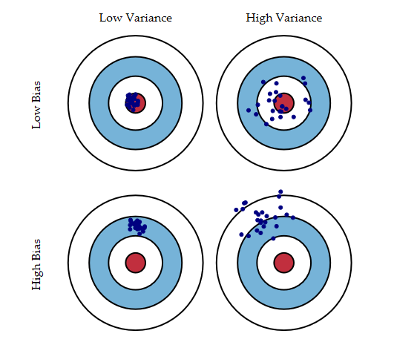
Bias-Variance Decomposition
Bias: the difference between the expected (or average) prediction of the model and the actual value
Variance: the variability of a model prediction for any given data point
Total Expected Error = Bias + Variance
Notes:
Theoretical tool for analyzing how much specific training set affects performance of classifier
Understanding how different sources of error lead to bias and variance helps us improve the data fitting process resulting in more accurate models. There is a tradeoff between a model's ability to minimize bias and variance. Understanding these two types of error can help us diagnose model results and avoid the mistake of over- or under-fitting.
Bias Measures how well the learning method matches the problem.
Small sample size increases variance.

Slide 20
Overview
Theory
Methods
Resampling Methods
Bagging
Randomization
Boosting
Hybrid Methods
Stacking
Implementations
Notes:
vary the data used to train a given algorithm
vary the algorithms trained on a given data

Slide 21
Bagging
Bagging, short for Bootstrap Aggregating, is one of the earliest ensemble based algorithms
It is also one of the most intuitive and simplest to implement, with a surprisingly good performance
Use bootstrapped replicas of the training data; large number of (say 200) training subsets are randomly drawn - with replacement - from the entire training data
Each resampled training set is used to train a different classifier of the same type
Individual classifiers are combined by taking a majority vote of their decisions
Bagging is appealing for small training set; relatively large portion of the samples is included in each subset

Slide 22
Bagging: Method
Bootstrap Aggregation Theory
Simplest way of combing predictions
Combine multiple Independent models, of same type, using vote with equal weight
Strategy
Diversify data sets via bootstrapping
Create multiple models build from each data set
Combining decisions of models
Using static “voting” (classification) or averaging/mean(regression)
Notes:
Classification uses weighted vote
Numeric prediction uses average vote
“Two heads are better than one”
Produce multiple classifiers from one data set
Application of bootstrap sampling
Given: set D containing m training examples
Create S[i] by drawing m examples at random with replacement from D
S[i] of size m: expected to leave out 0.37 of examples from D
Bagging
Create k bootstrap samples S[1], S[2], …, S[k]
Train distinct model on each S[i] to produce k classifiers
Classify new instance by classifier vote (equal weights)

Slide 23
Bootstrapping Review
Method for estimating the generalization error of a learning method
Resampling
Instances are randomly sampled with replacement to create new sample set to be applied to classifier to create model
Notes:
Create independent training dataset from original train data by altering the dataset by deleting some instances and replicating others.
Each sample is different from the original data set, but will be similar in distribution and variability.

Slide 24
Bagging pseudo code
Sample several training sets (D1, D2, D3)
size n from Data set D
using bootstrapping
Build a classifier for each training set (M)
Combine predictions (P)
D
Data D1
Data D2
Data d3
Model M
Model M
Model M
Prediction P1
Prediction P2
Prediction P3
P
Notes:
Bagged Classifiers hard to analyze

Slide 25
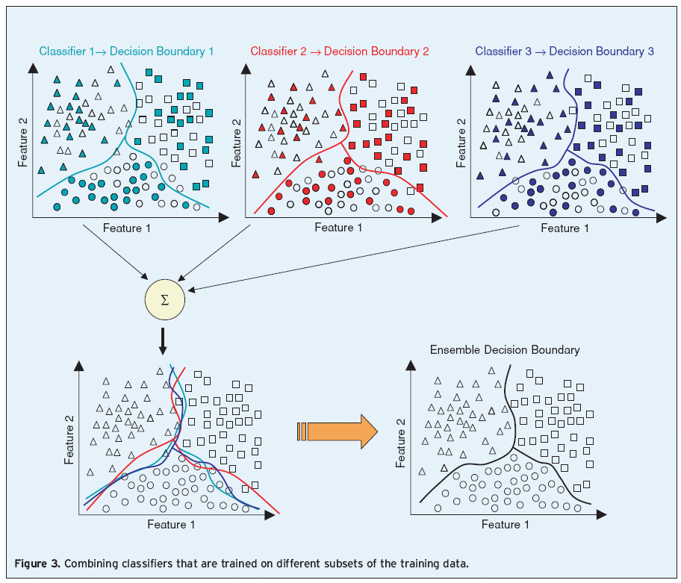
Sampling with Replacement
Random & overlapping training sets to train three classifiers; they are combined to obtain a more accurate classification

Slide 26
Bagging Pseudocode

Slide 27
Variations of Bagging
Random Forests
so-called because it is constructed from decision trees
A random forest is created from individual decision trees, whose training parameters vary randomly
Such parameters can be bootstrapped replicas of the training data, as in bagging
But they can also be different feature subsets as in random subspace methods

Slide 28
Bagging Summary
Uses Bootstrap resampling
Highly overlapping training sets
Bagging reduces error due to variance
Reducing the overall expected error
Usually more classifiers/models the better
Good with noisy data
Avoids over fitting
Good with unstable learners
Results are usually better then individual classifier
Notes:
When learner is unstable
Small change to training set causes large change in output hypothesis
True for decision trees, neural networks; not true for k-nearest neighbor
Experimentally, bagging can help substantially for unstable learners
Can possibly degrade results for stable learners
Instability a result of small datasets: Slight changes to the training data can result in a different attribute being chosen at a particular nodes, with significant ramifications for the sub tree structure (pg. 353)
generate new datasets of size n by sampling with replacement from original dataset

Slide 29
Randomization
Randomization
Modifies learning algorithm
Can be applied to stable learners
Randomization Implementations
Rotation Forests
Ensembles using rotated random subspaces
Random forests
Bag ensembles of random trees
Random Committee
Ensembles using different random number seeds
Random Subspace
Ensembles using rotated random subspaces

Slide 30
Boosting: Method
Theory
Construct Strong Classifier by weighting voting of the weak classifiers
Strong learners are very difficult to construct
Constructing weaker learners is relatively easy
Strategy
Construct Weak Classifier
Diversify using sequential adaptive resampling by weighting
“Boost” Weak Classifier to a strong learner
Combine Weak Classifiers
Integrate using weighted voting
Notes:
What Is A Weak Learner?
Takes labeled training data
Creates classifiers which will perform better than random guessing
Combine Weak Classifiers
Weighted Voting
Construct Strong Classifier by weighting voting of the weak classifiers
Goal
Weak Classifiers with better predictive power get larger weight
Iteratively add weak classifiers
To increase accuracy of the combined classifier though minimization of a cost function.

Slide 31
Weak vs. Strong Learners
Weak Classifiers (weak learners)
Classifiers which perform slightly better than a random classifier. These classifiers are considered have some predictive power.
Classifier which is only slightly correlated with the true classification (it can label examples better than random guessing)
Example: Decision Stump
Strong Classifier (strong learner)
classifier that is arbitrarily well-correlated with the true classification
Example: Naive Bayes, Neural Networks or SVM

Slide 32
Boosting
Boost the performance of a weak learner to the level of a strong one
Boosting creates an ensemble of classifiers by resampling the data; classifiers combined by majority voting
resampling is strategically geared to provide the most informative training data for each consecutive classifier
Boosting creates three weak classifiers:
First classifier C1 is trained with a random subset of the available training data
Training set for second classifier C2 is chosen as the most informative subset, given C1; half of the training data for C2 is correctly classified by C1, other half is misclassified by C1
Third classifier C3 is trained on instances on which both C1 & C2 disagree

Slide 33
Boosting
Create classifier using training dataset
Score each data point, indicating incorrect decisions or errors
Retrain, focusing on incorrect decisions
Repeat
Final Prediction is weighted average of all the models
Notes:
Dependent Method: (interaction between learning runs)
incrementally building an ensemble by training each new model instance to emphasize the training instances that previous models mis-classified. Score each datapoint, indicating
Weighting is used to influence more successful models
Iterative procedure - new models are influenced by performance of previously built ones
New model is encouraged to become expert for instances classified incorrectly by earlier models
Intuitive justification - models should be experts that complement each other
More likely to overfit data thatn bagging.

Slide 34
Boosting
Construct Weak Classifiers
Using different data distributions
Start with uniform weight
Iterate through method
Increase weights of the examples which are not correctly learned
Decrease weights of example which are correctly learned by the weak learner
Focus on difficult example what are not correctly classified in previous step
Weighted D1
Model M
Prediction P1
error
Weighted D2
Model M
Prediction P2
error
…
error
…
Weighted Dn
Model M
Prediction Pn
Notes:
Reweight example where classification is incorrect
Combine models via the weighted sum.

Slide 35
Boosting Pseudo Code

Slide 36
AdaBoost
AdaBoost (1997) is a more general version of the boosting algorithm; AdaBoost.M1 can handle multiclass problems
AdaBoost generates a set of hypotheses (classifiers), and combines them through weighted majority voting of the classes predicted by the individual hypotheses
Hypotheses are generated by training a weak classifier; samples are drawn from an iteratively updated distribution of the training set
This distribution update ensures that instances misclassified by the previous classifier are more likely to be included in the training data of the next classifier
Consecutive classifiers are trained on increasingly hard-to-classify samples

Slide 37
AdaBoost
A weight distribution D_{t}(i) on training instances x_{i} , i=1,…,N from which training data subsets S_{t} are chosen for each consecutive classifier (hypothesis) h_{t}
A normalized error is then obtained as β_{t} , such that for 0<ε_{t} <1/2, they have 0< β_{t} <1
Distribution update rule:
The distribution weights of those instances that are correctly classified by the current hypothesis are reduced by a factor of β_{t} , whereas the weights of the misclassified instances are unchanged.
AdaBoost focuses on increasingly difficult instances
AdaBoost raises the weights of instanced misclassified by h_{t} , and lowers the weights of correctly classified instances
AdaBoost is ready for classifying unlabeled test instances. Unlike bagging or boosting, AdaBoost uses the weighted majority voting
1/β_{t} is therefore a measure of performance, of the t^{th} hypothesis and can be used to weight the classifiers

Slide 38
AdaBoost.M1

Slide 39
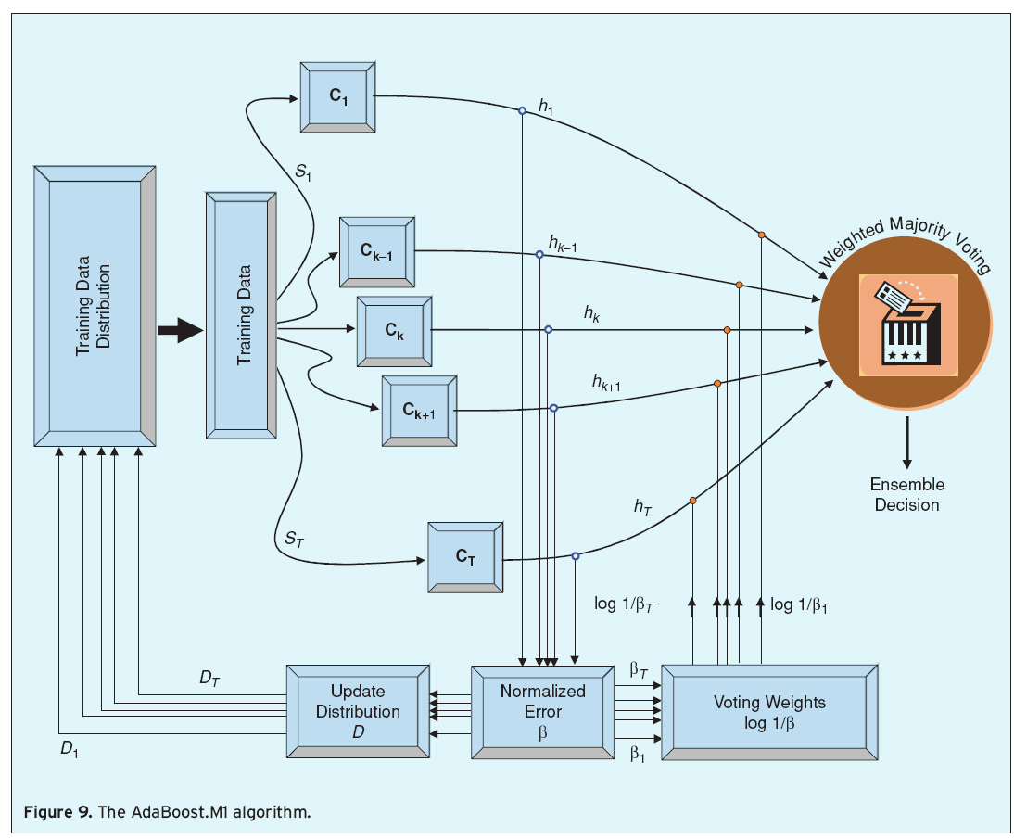
AdaBoost.M1
AdaBoost algorithm is sequential; classifier (CK-1) is created before classifier CK

Slide 40
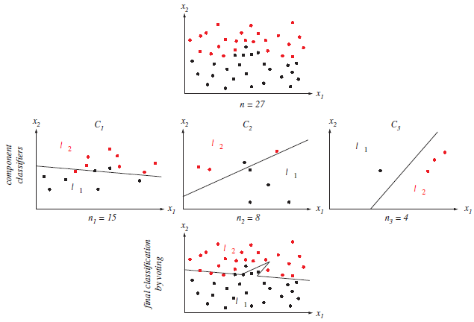
Boosting
Notes:
A two dimensional two-category classification task is shown at the tip
The middle row shows 3 component (linear) classifiers Ck trained by LMS algorithm where their training pattern were chosen through the basic boosting procedure
The final classification is given by the voting of the three component classifiers and yields a nonlinear decision boundary as shown in the bottom
Given that the component classifiers are weak learners (i.e. each can learn a training set better than a chance) then the ensemble classifiers will have a lower training error on the full training set D than does any single component classifier

Slide 41
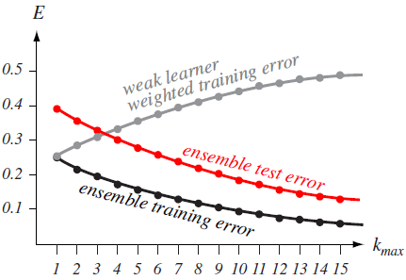
AdaBoost Performance
In most practical cases, the ensemble error decreases very rapidly in the first few iterations, and approaches zero or stabilizes as new classifiers are added
Notes:
AdaBoost applied to a weak learning system ca reduce the training error E exponentially as the number of component classifiers Kmax is increased
Because AdaBoost “focuses on” Difficult training patterns, the training error of each successive component classifier (measured on its own weighted trianing set) is generally larger that that of any previous component classifier (shown in grey)
Netervtheless, so long as the component classifier sperfomr better than chance (e.g. have error less than 0.5 on a tow –category problem) the weighted ensemble decision nsures that the training error will decrease, as given by …
It is often found that the test error decreases in boosted systems as well as hown in red
AdaBoost does not seem to be affected by overfitting

Slide 42
MART (multiple additive regression trees)
MART is a boosting algorithm for regression
Input: a learning sample {(x_{i},y_{i}): i=1,…,N}
Initialize
ŷ₀(x) = 1/N å_{i} y_{i} ; r_{i}=y_{i}, i=1,…,N
For t=1 to T:
For i=1 to N, compute the residuals
r_{i} ← r_{i} -ŷ_{t-1}(x_{i})
Build a regression tree from the learning sample {(x_{i},r_{i}): i=1,…,N}
Return the model ŷ(x)= ŷ₀(x)+ŷ₁(x)+…+ŷ_{T}(x)

Slide 43
Boosting Methods
Many types of boosting algorithms
Boosting decision/regression trees improves their accuracy often dramatically
For Boosting to work, the models need not to be perfect on the learning sample
With trees, there are two possible strategies:
Use pruned trees (pre-pruned or post-pruned by cross-validation)
Limit the number of tree tests (and split first the most impure nodes)
⇒ bias/variance tradeoff with respect to the tree size
Notes:
Adaboost and MART are only two boosting variants There are many other boosting type algorithms
Boosting decision/regression trees improves their accuracy often dramatically. However, boosting is more sensible to noise than averaging techniques (overfitting)
For boosting to work, the models need not to be perfect on the learning sample. With trees, there are two possible strategies:
Use pruned trees (pre-pruned or post-pruned by cross-validation)
Limit the number of tree tests (and split first the most impure nodes)
⇒ there is again a bias/variance tradeoff with respect to the tree size

Slide 44
Boosting: Summary
Sensitive to noise
when base learners misclassify noisy examples, weights increase, causes over fitting to noise
The power of boosting comes from adaptive resampling
Like bagging, boosting reduces variance
Reduces bias focusing on learning “hard cases”
Results usually better then individual classifier or bagging

Slide 45
Stacking Stacked Generalization
Theory
Train on multiple models of different type
Combines multiple different learning algorithm models using a meta learner
Strategy
Uses Meta learners to identify “reliable” classifiers
Notes:
* If you have 3 different models based on three different learning algorithms. Normally you would evalute the best model(based on expected error of each algorithm by corss validation and choose best one to form a model for prediction on future data. However it would be nice if we could take advantage of Epicurus’ Principle
“keep all theories that are consistent with the data”, and use all three for prediction and combine the outputs.
Stacking is a meta learner, which replaces the voting procedure utilized by bagging and boosting. The problem with voting (as we see in politics) , it is not clear which classifier to “trust”.
Stacking tries to learn which classifiers are reliable, by using a “meta-learner” to discover how to best combine the output of the base learners.
Used to combine models of different types
DT, Naïve Bayes and k-nearest neighbor
With several algorithms available, instead of performing cross validation and selecting the best one it’s better to combine them
Use un-weighted voting (as in bagging) only makes sense only if the learning algorithms perform comparably well
Stacking uses a meta learner instead of voting – the goal of the meta
it is not clear which classifier to trust
learner is to learn which classifiers are the reliable ones
Hard to analyze theoretically - “black magic”
Uses meta learner instead of voting to combine predictions of base learners
Predictions of base learners ( level-0 models) are used as input for meta learner ( level-1 model)
Base learners usually different learning schemes
Predictions on training data can’t be used to generate data for level-1 model!
Cross-validation-like scheme is employed

Slide 46
Stacking: Pseudo code
Train level-0, or base, models as usual
Train multiple learners (Level -0 /base learners)
Each uses subsample of D
Train ‘combiner’ on validation segment D (Level-1 Model)
Level-1 data built from predictions of level-0 models on remainder of set
Level-1 Generalizers are models trained on level-1 data
Notes:
First, all of the other algorithms are trained using the available data, then a combiner algorithm is trained to make a final prediction using all the predictions of the other algorithms as additional inputs. If an arbitrary combiner algorithm is used, then stacking can theoretically represent any of the ensemble techniques described in this article, although in practice, a single-layer logistic regression model is often used as the combiner.
Meta learner(combiner) is called level–1 model
Base classifiers - level-0 models
Outputs of the level-0 models are inputs to the level-1 model

Slide 47
Stacking Visualized
Final Classifcation
Level-1 Classifier
Model M
Level-1 Training
Data
Data D1 = target values of D0 + Predictions of P(i)
Prediction P1
Prediction P2
Prediction Pn
Level-0 Predictions
Model M1
Model M2
Model Mj
Level-0 Classifier
Level-0 Training
Data
Data D0

Slide 48
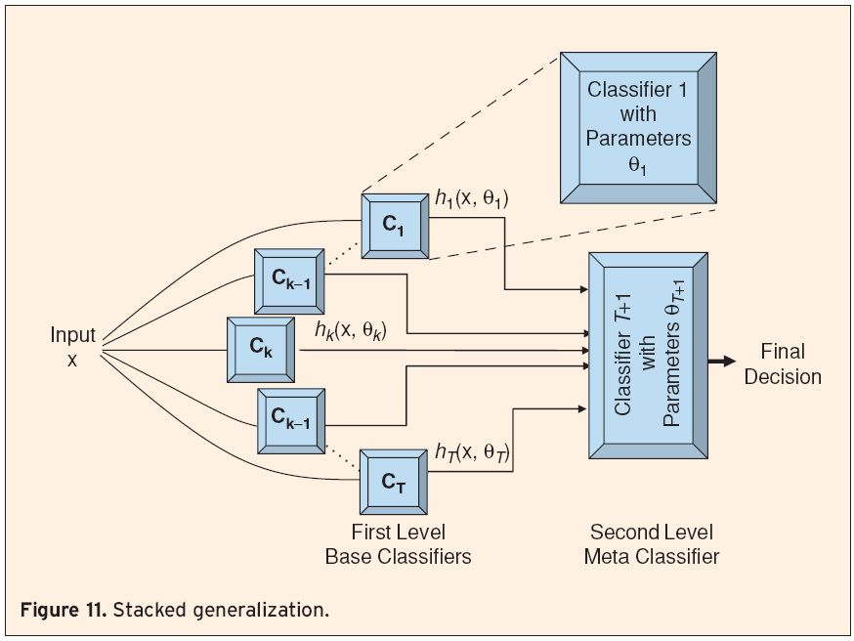
Stacked Generalization
An ensemble of classifiers is first created, whose outputs are used as inputs to a second level meta-classifier to learn the mapping between the ensemble outputs and the actual correct classes
C₁, …,C_{T} are trained using training parameters θ₁ through θ_{T} to output hypotheses h₁ through h_{T}
The outputs of these classifiers and the corresponding true classes are then used as input/output training pairs for the second level classifier, C_{T+1}

Slide 49
Stacking Summary
Stacking is a meta-learner
Difficult to analyze theoretically
Use probabilities as base learners if possible
it’s better to use those as input to meta learner
Choosing Level -1 Learners
In principle, any learning scheme
David Wolpert: “relatively global, smooth” model
Base learners do most of the work
Reduces risk of over fitting
Notes:
improves considerably over cross-validated model selection
on average, 3 hypotheses play a significant role in the combined hypothesis
Training sets for “leaves”: sampled with replacement; combiner: validation set

Slide 50
Weka Implementations
Bagging: Bagging
MetaCost
Randomization
Random Committee
Random Forest
Boosting
AdaBoostM1
MultiBoostAB
Stacking: Stacking
StackingC

Slide 51
R Implementations
Bagging:
Ipred
Adabag: Adaboost and Bagging
Randomization
randomForest: Random Forest
Party: RF with faster tree growing
Boosting
Ada: (AdaBoost + Friedmans mods)
Qbm: (Stochastic Gradient boosting)
Mboost: (Boosting applied to glm, gam)
Stacking: Stacking
StackingC
Notes:
http://blog.revolutionanalytics.com/2014/04/ensemble-packages-in-r.html
ipred does bagging which has been incorporated into both Random Forest and Gradient Boosting. But the ipred package has the ability to incorporate more than one type of base learner. One of the examples in the package documentation incorporates Linear Discriminant Analysis in addition to Binary Decision Tree. It is hard to find ensemble methods using base learners other than binary decision trees. Simultaneously using two (or more) different base learners is singular to this package.
Random Forest: It solves regression and classification problems, has an unsupervised mode, produces marginal plots of prediction versus individual attributes, ranks attributes by importance. It also produces a similarity matrix measuring how frequently two rows from the input wind up in the same leaf node together. That gives a measure of how close the two rows are in their effect on the trained model.

Slide 52
Python Implementations
Sklearn.ensemble Methods
ensemble.AdaBoostClassifier([...]) | An AdaBoost classifier
ensemble.AdaBoostRegressor([base_estimator, ...]) | An AdaBoost regressor.
ensemble.BaggingClassifier([base_estimator, ...]) | A Bagging classifier.
ensemble.BaggingRegressor([base_estimator, ...]) | A Bagging regressor.
ensemble.ExtraTreesClassifier([...]) | An extra-trees classifier.
ensemble.ExtraTreesRegressor([n_estimators, ...]) | An extra-trees regressor.
ensemble.GradientBoostingClassifier([loss, ...]) | Gradient Boosting for classification.
ensemble.GradientBoostingRegressor([loss, ...]) | Gradient Boosting for regression.
ensemble.RandomForestClassifier([...]) | A random forest classifier.
ensemble.RandomTreesEmbedding([...]) | An ensemble of totally random trees.
ensemble.RandomForestRegressor([...]) | A random forest regressor.

Slide 53
Summary
Ensemble Learning
Ensemble systems are useful in practice
Techniques to combine models to improve predictive performance
The error of an ensemble is less than the error of an individual model if:
Models are diverse and independent
Models performance is slightly better then random (err < 0.5)
No single ensemble generation algorithm or combination rule is universally better than others
Effectiveness on real world data depends on the classifier diversity and characteristics of the data
Notes:
What are similarities and differences between bagging and boosting?
1. Both can be applied to both classification and numeric prediction.
2. Both use voting (for classification) or averaging (for numeric prediction). However, in bagging the models receive equal weight, and in boosting the models are weighted by confidence to give more influence to the more successful ones.
3. In bagging, individual models are built separately, which means they can be built in parallel. In boosting, each new model is influenced by the performance of those built previously. Boosting encourages new models to become experts for instances handled incorrectly by earlier ones by assigning greater weight to those instances. Boosting models must be built sequentially since each new one depends on the results of the previous ones.
4. Both combine models of the same type – for example, decision trees.
5. Both work with weak or unstable learners. Boosting is limited in that the error when building the model cannot exceed 50%.
6. Both use sampling with replacement
7. Bagging reduces the variance of unstable methods, while boosting methods reduces both the bias and variance of unstable methods but increased the variance for Naive-Bayes (which is very stable) http://robotics.stanford.edu/~ronnyk/vote.pdf
8. Unlike bagging, boosting sometimes fails in practical situations: It can generate a classifier that is significantly less accurate than a single classifier built from the same data. This indicates that the combined classifier overfits the data.
9. In boosting, the training error will theoretically decrease exponentially.
10. If boosting does succeed in reducing the error on fresh test data, it often does so in a spectacular way.
Ensemble systems are useful in practice
Diversity of the base classifiers is important
Ensemble generation techniques: bagging, AdaBoost, mixture of experts
Diverse classifier combination strategies
No single ensemble generation algorithm or combination rule is universally better than others
Effectiveness on real world data depends on the classifier diversity and characteristics of the data

